Slide 1


WEBSITE USING VMSS (VIRTUAL MACHINE SCALE SET)
BATCH - 04
1) M. MAITHRI (21891A0437)
2) V. KOUSHIK (21891A04C7)
3) T. NANDA KUMAR (21891A04B5)
4) N. KARTHIK (22895A0402)

Slide 2
INTRODUCTION
In today’s dynamic cloud computing environment, businesses and applications require high availability, scalability, and efficient resource management. Virtual Machine Scale Sets (VMSS) in Microsoft Azure provide an automated and flexible solution for deploying and managing a group of identical Virtual Machines (VMs) to meet fluctuating workloads.
With VMSS, organizations can:
Auto-scale resources based on demand, ensuring cost efficiency.
Improve high availability by distributing workloads across multiple instances.
Easily integrate with Azure Load Balancer and Azure Application Gateway for traffic management.
Simplify management with uniform configurations and centralized updates.
VMSS is widely used for large-scale applications, microservices architectures, big data processing, and containerized workloads. By leveraging VMSS, businesses can achieve seamless performance and reliability while optimizing cloud infrastructure costs.
Scale smarter, deploy faster, and maximize efficiency with Azure VMSS!

Slide 3
STEPS FOR THE PROJECT
Making a highly aval. website using VMSS:-
1. website creation.
2. github upload (https://github.com/harisaideepu-cloud/oxer.git)
3. create VM with custom script
4. after deployment - check vm if our website is working or not
5. Capture > image > delete vm check box on> "imagegallery" > "imagedef" > version 1.0.0 > create
6. create vmss from the output
7. check if the image is our image or something else.
8. Set autoscaling (1,2,1) 25% increase 10% decrease , create loadbalancer in networking tab
9. create VMSS
10. after creation > go to instances > select the vm > copy and paste your ip address in new tab to check your website is live
11. go back in the vm > set inbound rule (*) in network settings > connect to vm in powershell > run stress test ( stress --cpu 1 --vm 1 --io 1 --hdd 1 --timeout 5m )
12. come back to portal in vmss > metrics > percentage cpu graph, set time to last 30min and 1 min update > look if the stress is working and check/refresh the instances in other tab > once the cpu stress is beyond our given rule, the instance would increase to 1.
13. show that we can access the website via 2 instances ip address and is highly available.

Slide 4
PROJECT OVERVIEW
1. Virtual Machine (VM):-
A VM is a software-based emulation of a physical computer that runs an operating system and applications independently. It provides isolation, flexibility, and scalability in both cloud and on-premises environments.
Use Cases: Development, testing, hosting applications, and cloud computing.
2. Virtual Machine Scale Sets (VMSS):-
A VM Scale Set (VMSS) is a collection of identical VMs in Azure that automatically scale up or down based on demand. It ensures high availability and load balancing across multiple instances.
Benefits:
Auto-scaling based on CPU, memory, or custom metrics.
Load balancing across multiple instances.
3. Load Balancer:-
A Load Balancer distributes network traffic across multiple servers or VMs to prevent overloading a single instance and improve reliability and performance.
Types of Load Balancers:
Azure Load Balancer – Layer 4 (TCP/UDP) traffic distribution.
Azure Application Gateway – Layer 7 (HTTP/HTTPS) intelligent routing.
Traffic Manager – DNS-based global load balancing.
Use Cases:
Ensures even traffic distribution among VMs in VMSS.
Redirects requests to healthy instances.

Slide 5
4. Stress Testing:-
Stress testing evaluates how a system (VM, VMSS, or application) performs under extreme conditions such as high traffic, memory consumption, or CPU usage.
Identifying performance bottlenecks in VMSS deployments.
Evaluating how a Load Balancer handles peak traffic.
Ensuring application reliability under stress conditions.
5. Image (VM Image):-
A VM Image is a pre-configured template containing an operating system, applications, and configurations needed to deploy VMs quickly.
Types of VM Images:
Azure Marketplace Images – Prebuilt OS images (Windows, Linux).
Custom Images – User-created templates for specific workloads.
Shared Image Gallery – Centralized management of custom images.
Use Cases:
Creating consistent VM instances in VMSS.
Rapid deployment of new VMs.
Ensuring security and compliance with pre-configured settings.

Slide 6
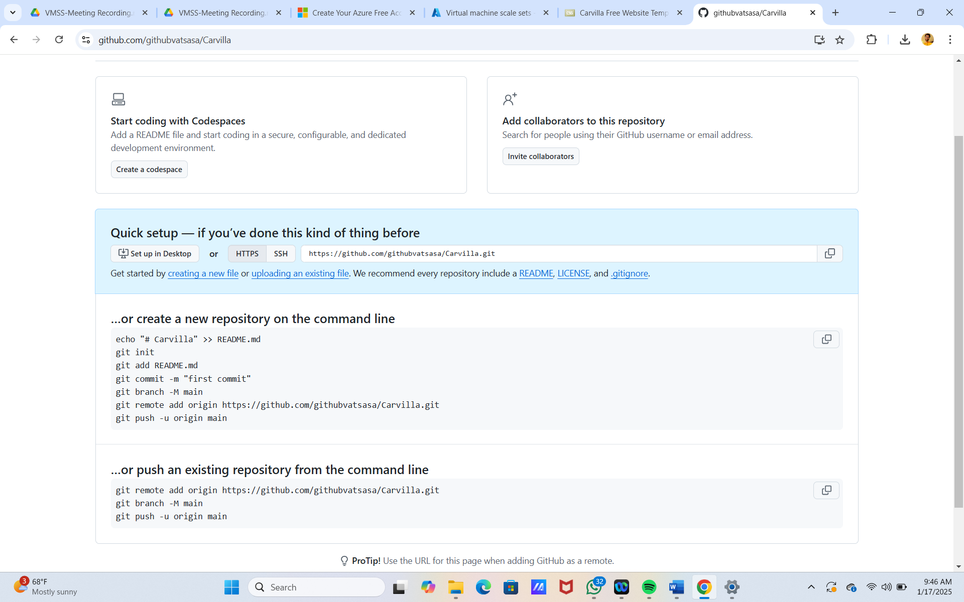
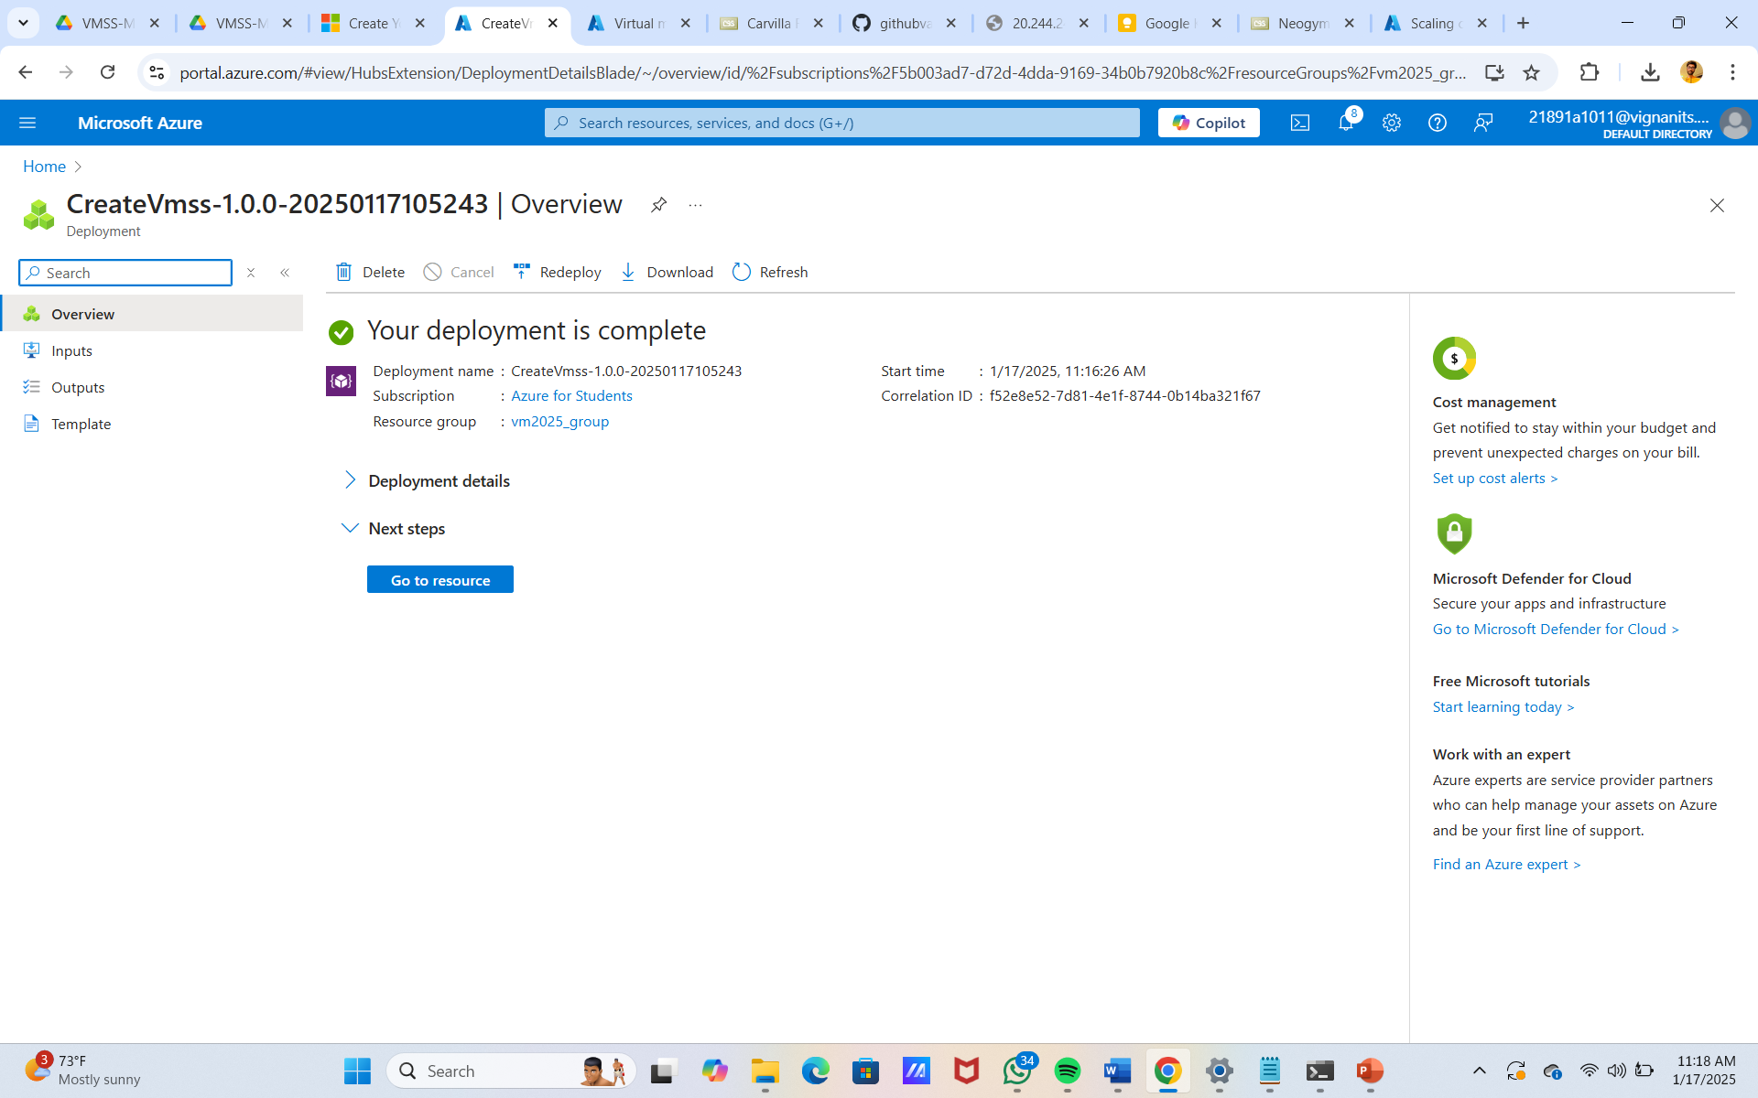
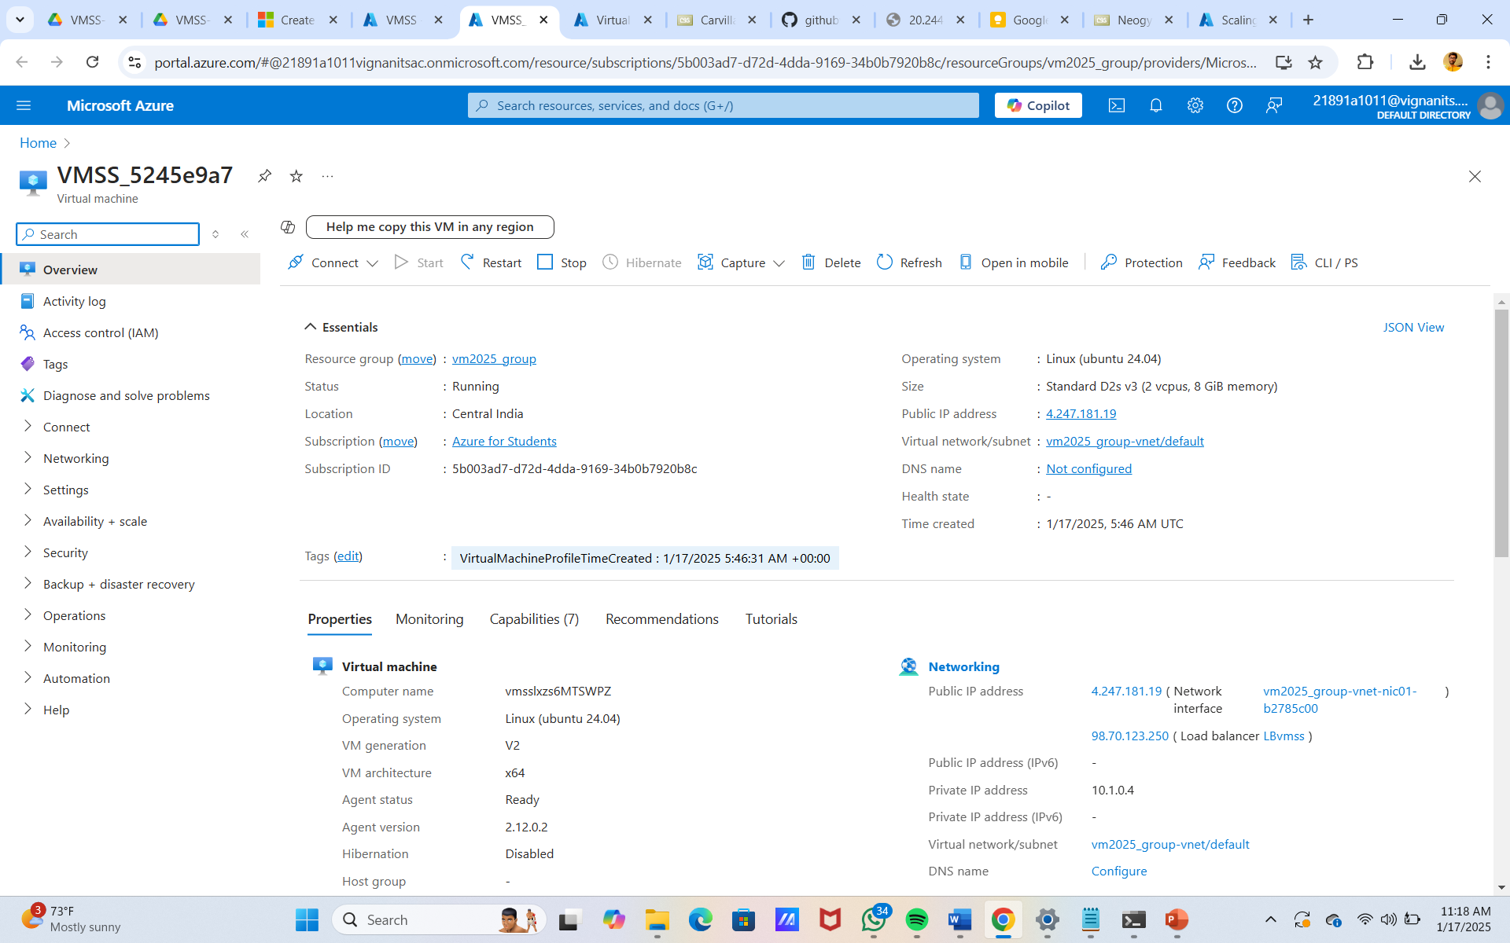
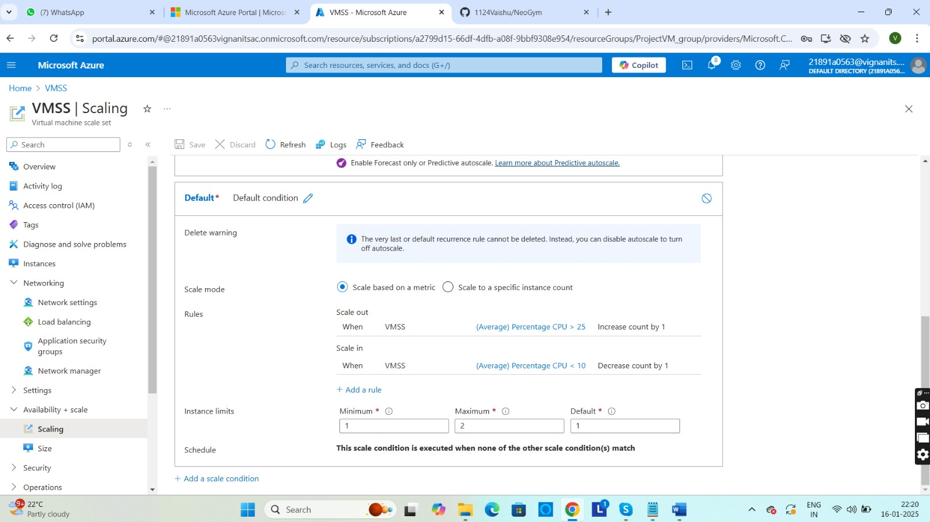
PICS FOR PROJECT OVERVIEW

Slide 7
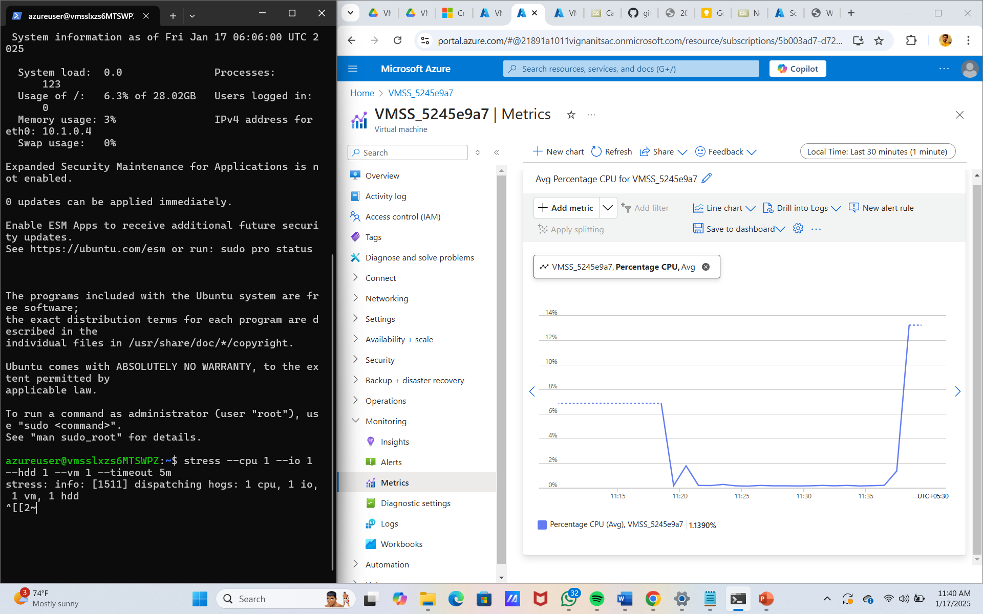
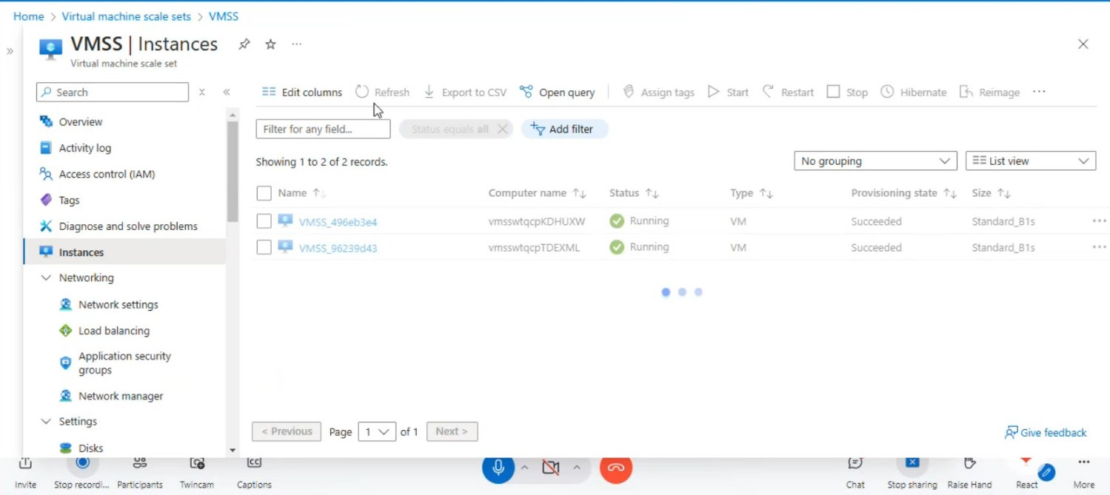
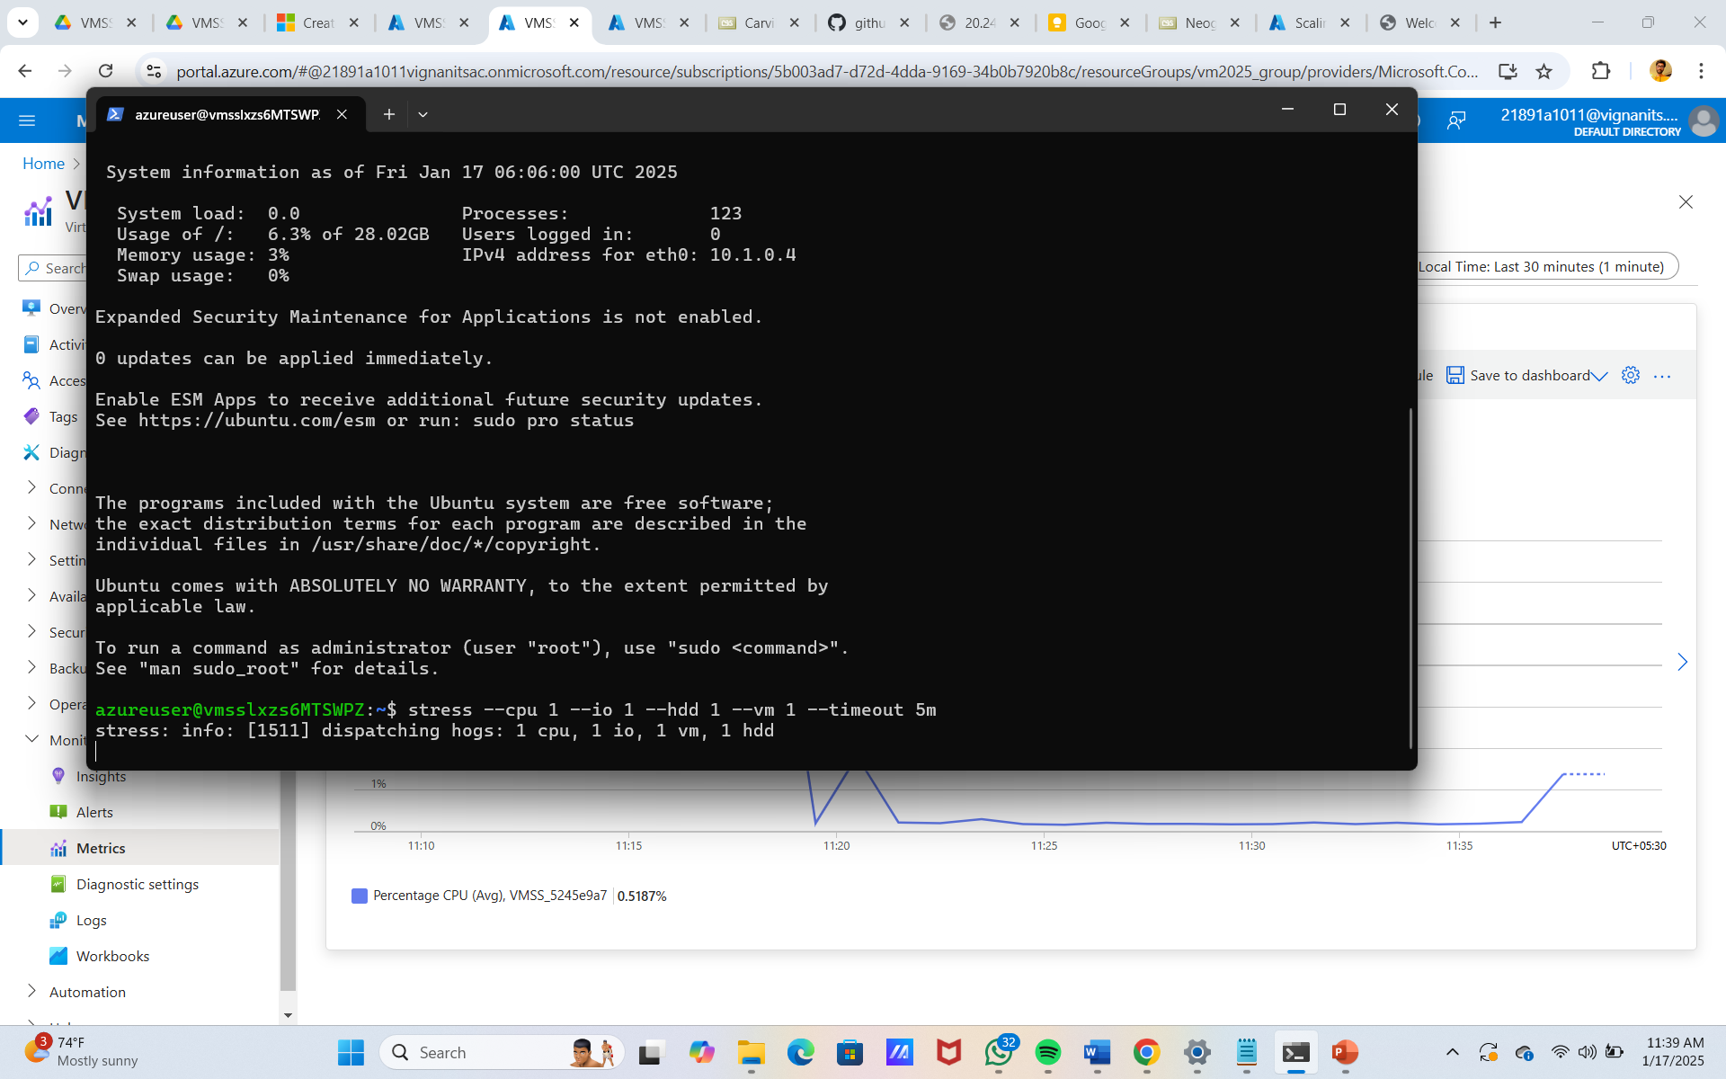

Slide 8
ADVANTAGES
Auto-Scaling for High Availability VMSS automatically scales up or down based on CPU, memory, or custom metrics.Ensures application availability during traffic spikes and reduces costs during low usage.
Load Balancing for Better Performance Works with Azure Load Balancer to distribute incoming traffic evenly across VM instances.Prevents any single VM from being overloaded, ensuring high performance and low latency.
Cost Optimization Reduces costs by dynamically adjusting the number of VMs based on demand.Supports Azure Spot VMs, which are cheaper and ideal for workloads that can tolerate interruptions.
Fault Tolerance & High Availability Distributes VMs across Availability Zones and Fault Domains to improve resiliency.Ensures minimal downtime in case of hardware failures or data center outages.
Automated OS & Application Updates Supports rolling updates, allowing VMs to be updated without downtime.Ensures that the latest security patches and software updates are applied seamlessly.
Easy Deployment & Management Can be deployed using ARM templates, Terraform, Azure CLI, or PowerShell.Works with Azure Monitor and Azure Auto-scale for automated monitoring and scaling.
Seamless Integration with Azure Services Works with Azure Kubernetes Service (AKS) for containerized workloads.Can be combined with Azure Virtual Network (V-Net) for secure communication between VMs.

Slide 9
CONCLUSION
Azure Virtual Machine Scale Sets (VMSS) provide a powerful solution for building highly available and scalable websites. With features like autoscaling, load balancing, and reusable VM images, it ensures reliability, fault tolerance, and cost efficiency. By automating scaling and optimizing resource usage, VMSS simplifies management while delivering seamless performance, making it an ideal choice for modern web applications

